Slide 1
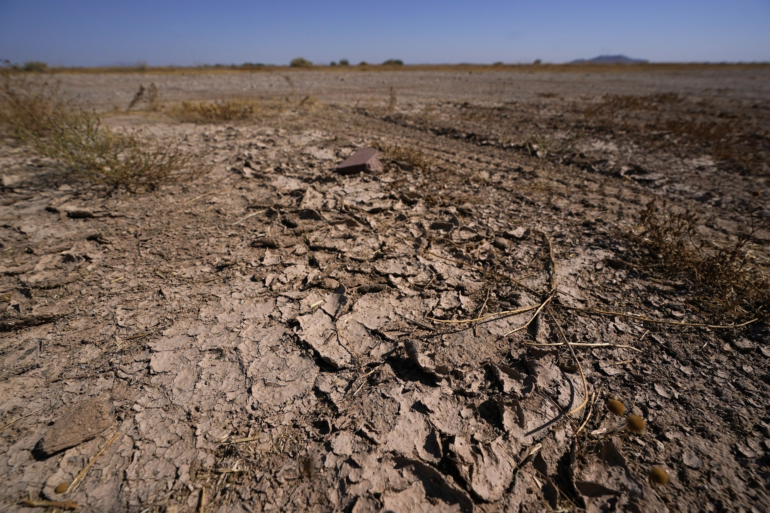
The Montana Mesonet
and
UMRB Soil Moisture and
Snowpack Monitoring
Kyle Bocinsky
Director of Climate Extension
Montana Climate Office
University of Montana

Slide 2


Montana's official climate data stewards.
Provides high quality, timely, relevant, and scientifically-based climate information and services to Montanans.
Operates the Montana Mesonet — an extensive and growing network of weather, soil moisture, and snowpack monitoring stations.

Slide 3
Montana Mesonet: A collaborative model
142 stations across the state (and growing!)
Notes:
A densely spaced network that serves landowners and agencies with local soil moisture and weather information required for daily to seasonal decisions
Conduct research and education for application of data
Co-develop user-guided applications and web-interfaces to share data and products
Use Mesonet data to verify drought conditions and improve gridded data sets across MT

Slide 4
Montana Mesonet: A collaborative model
Federal, State, and Private Partnerships
US Army Corps of Engineers
National Oceanographic and Atmospheric Administration (NOAA)
DOI Bureau of Land Management
USDA Forest Service
MT Department of Agriculture
MSU Agricultural Research Centers
Stillwater County (Maureen Davey)
Montana Bureau of Mines and Geology
Bureau of Indian Affairs: Little Big Horn College, Crow Agency
Fort Peck Tribes
Blackfeet Nation
Montana Department of Natural Resources and Conservation
Lolo Watershed Group
Musselshell Watershed Coalition
Blackfoot Challenge
Trout Unlimited
National Drought Resiliency Partnership
Community Collaborative Rain, Hail and Snow Network (CoCoRahs)
Roberts L7 Ranch
Private landowners
142 stations across the state (and growing!)
Notes:
A densely spaced network that serves landowners and agencies with local soil moisture and weather information required for daily to seasonal decisions
Conduct research and education for application of data
Co-develop user-guided applications and web-interfaces to share data and products
Use Mesonet data to verify drought conditions and improve gridded data sets across MT

Slide 5
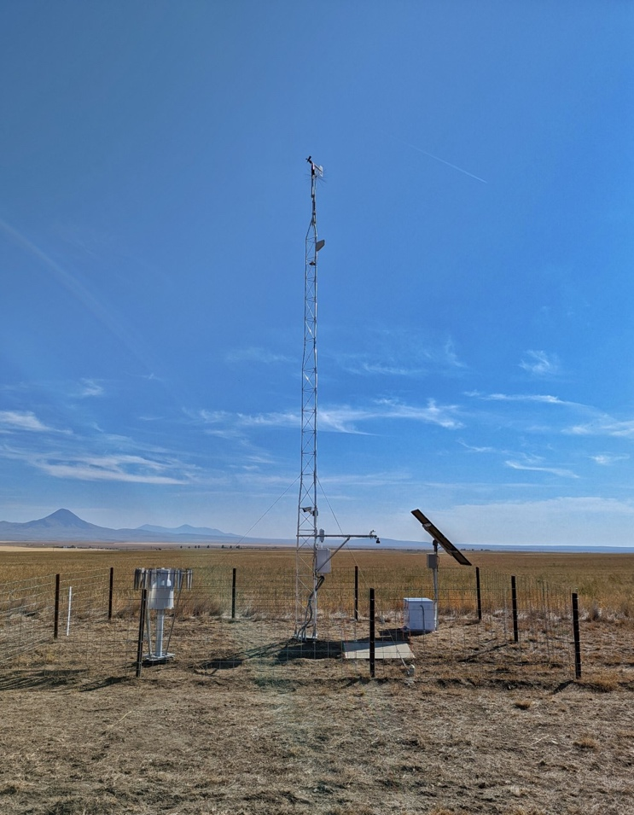

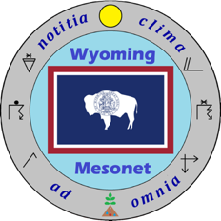
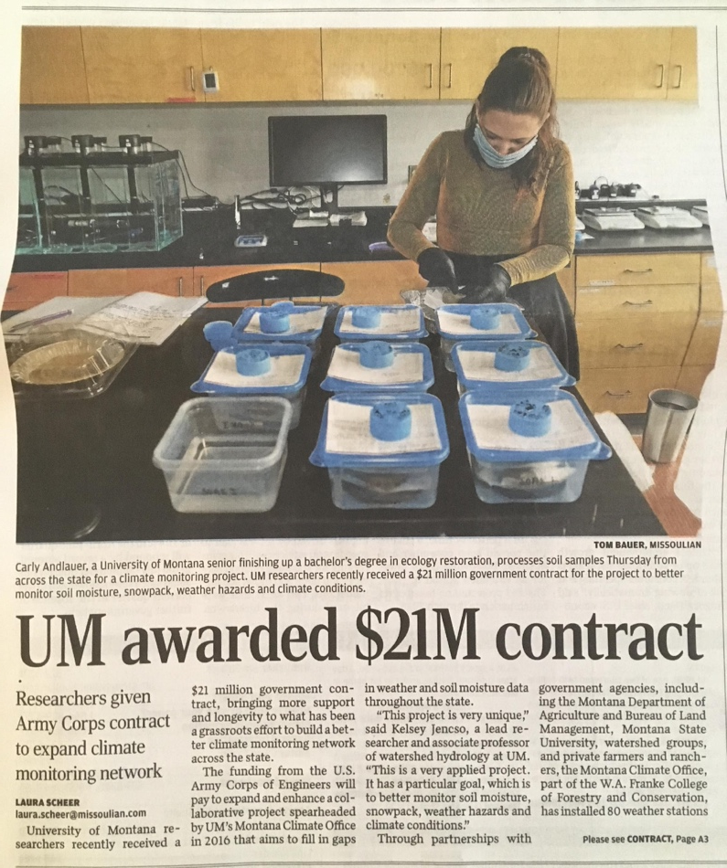




Montana Mesonet: Building the HydroMet

Slide 6
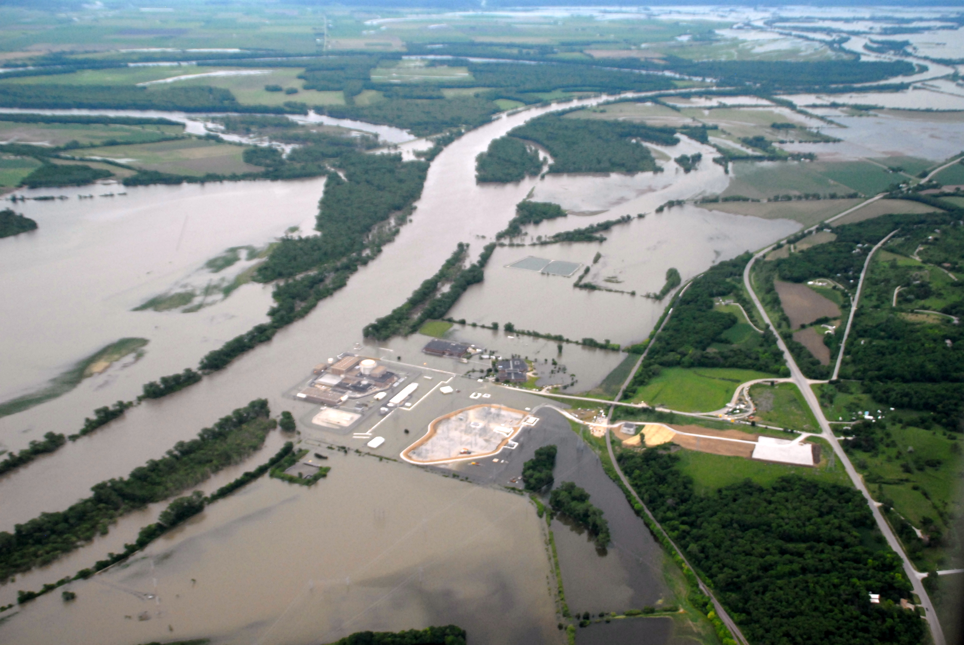
Corps of Engineers photo of June 16, 2011, showing the Fort Calhoun nuclear power plant surrounded by flood water

Slide 7
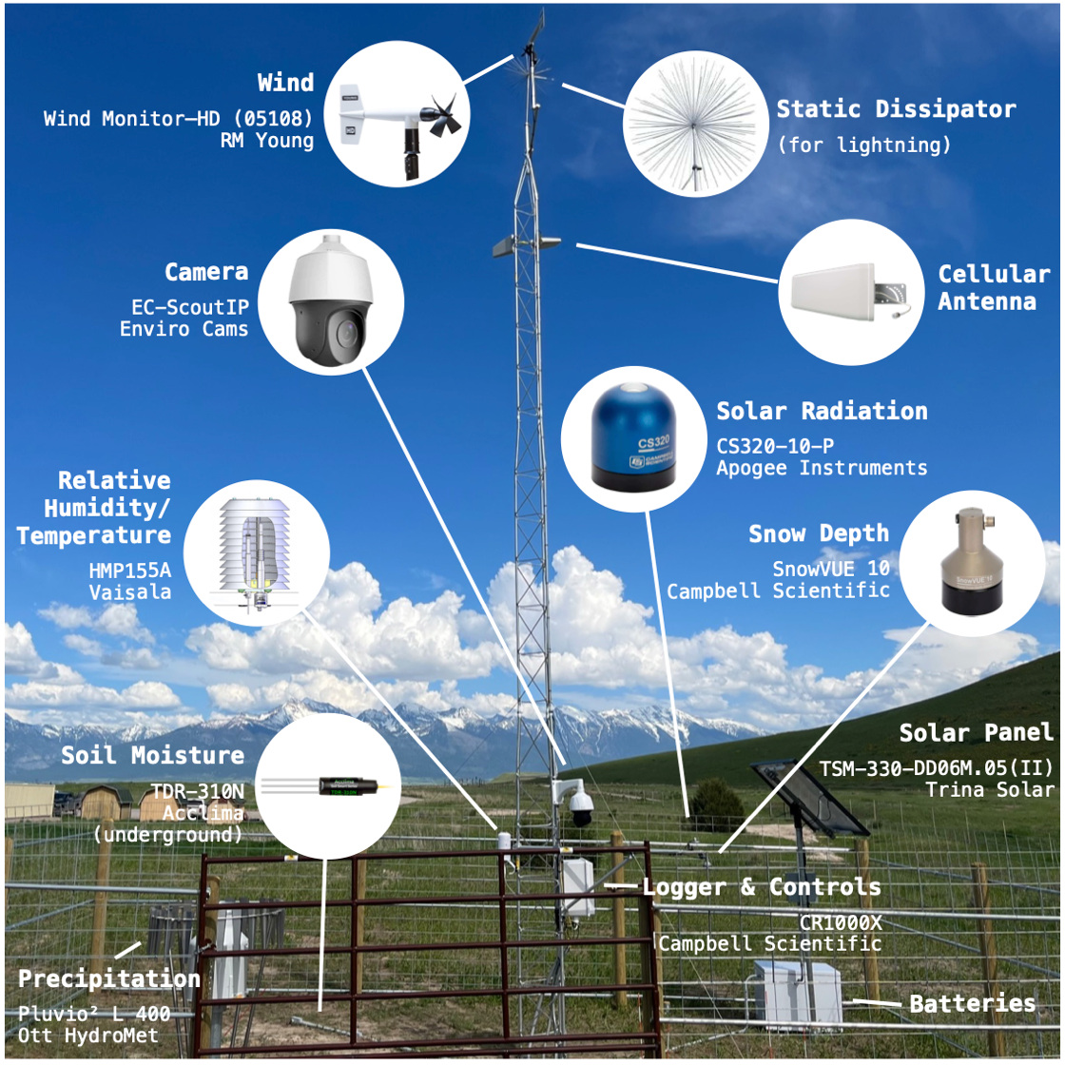

Slide 8
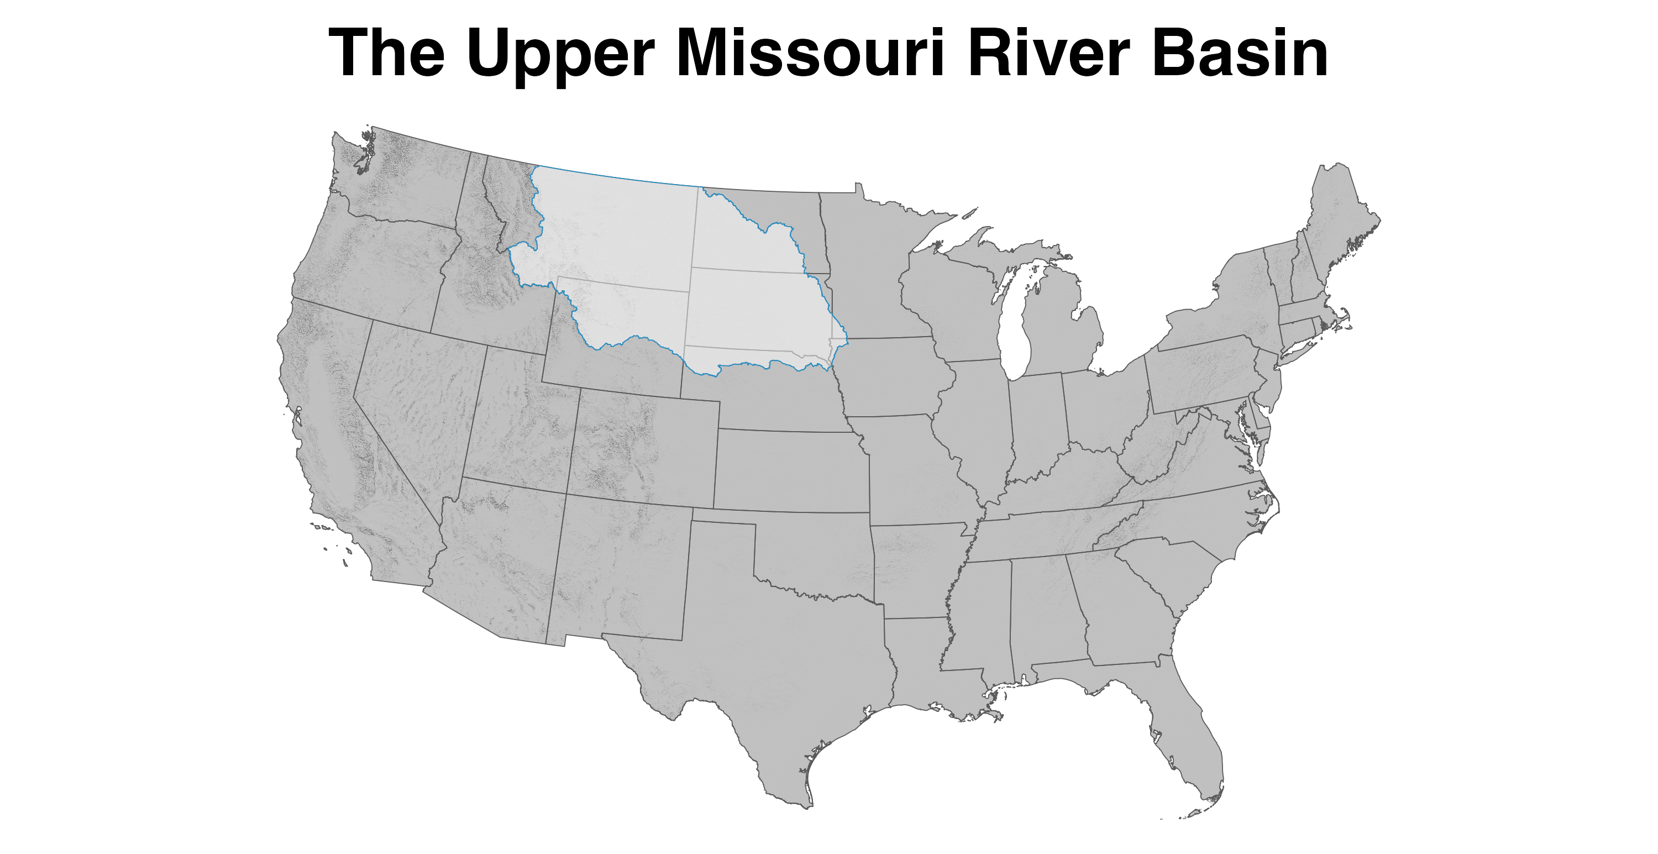

Slide 9
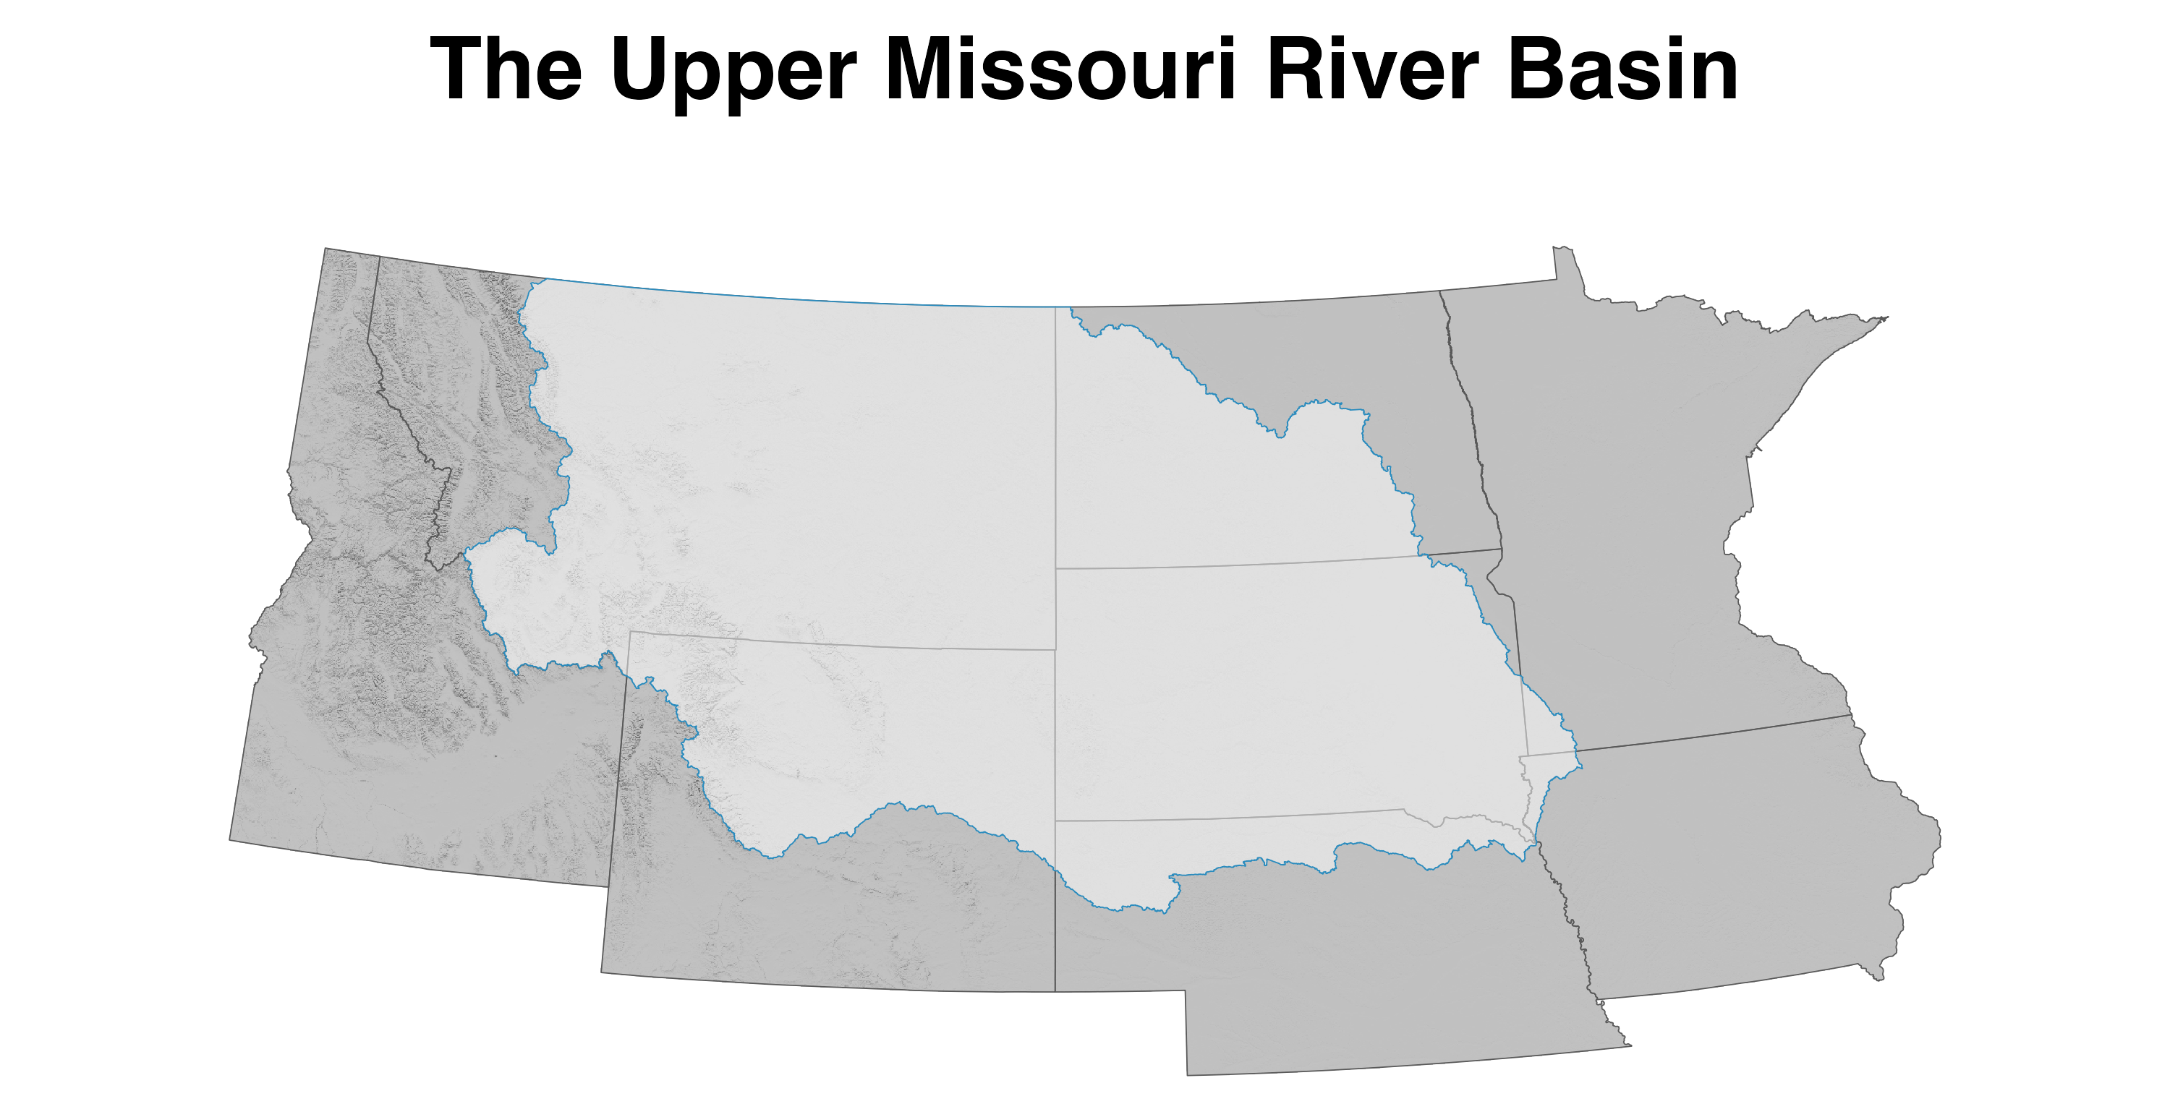

Slide 10
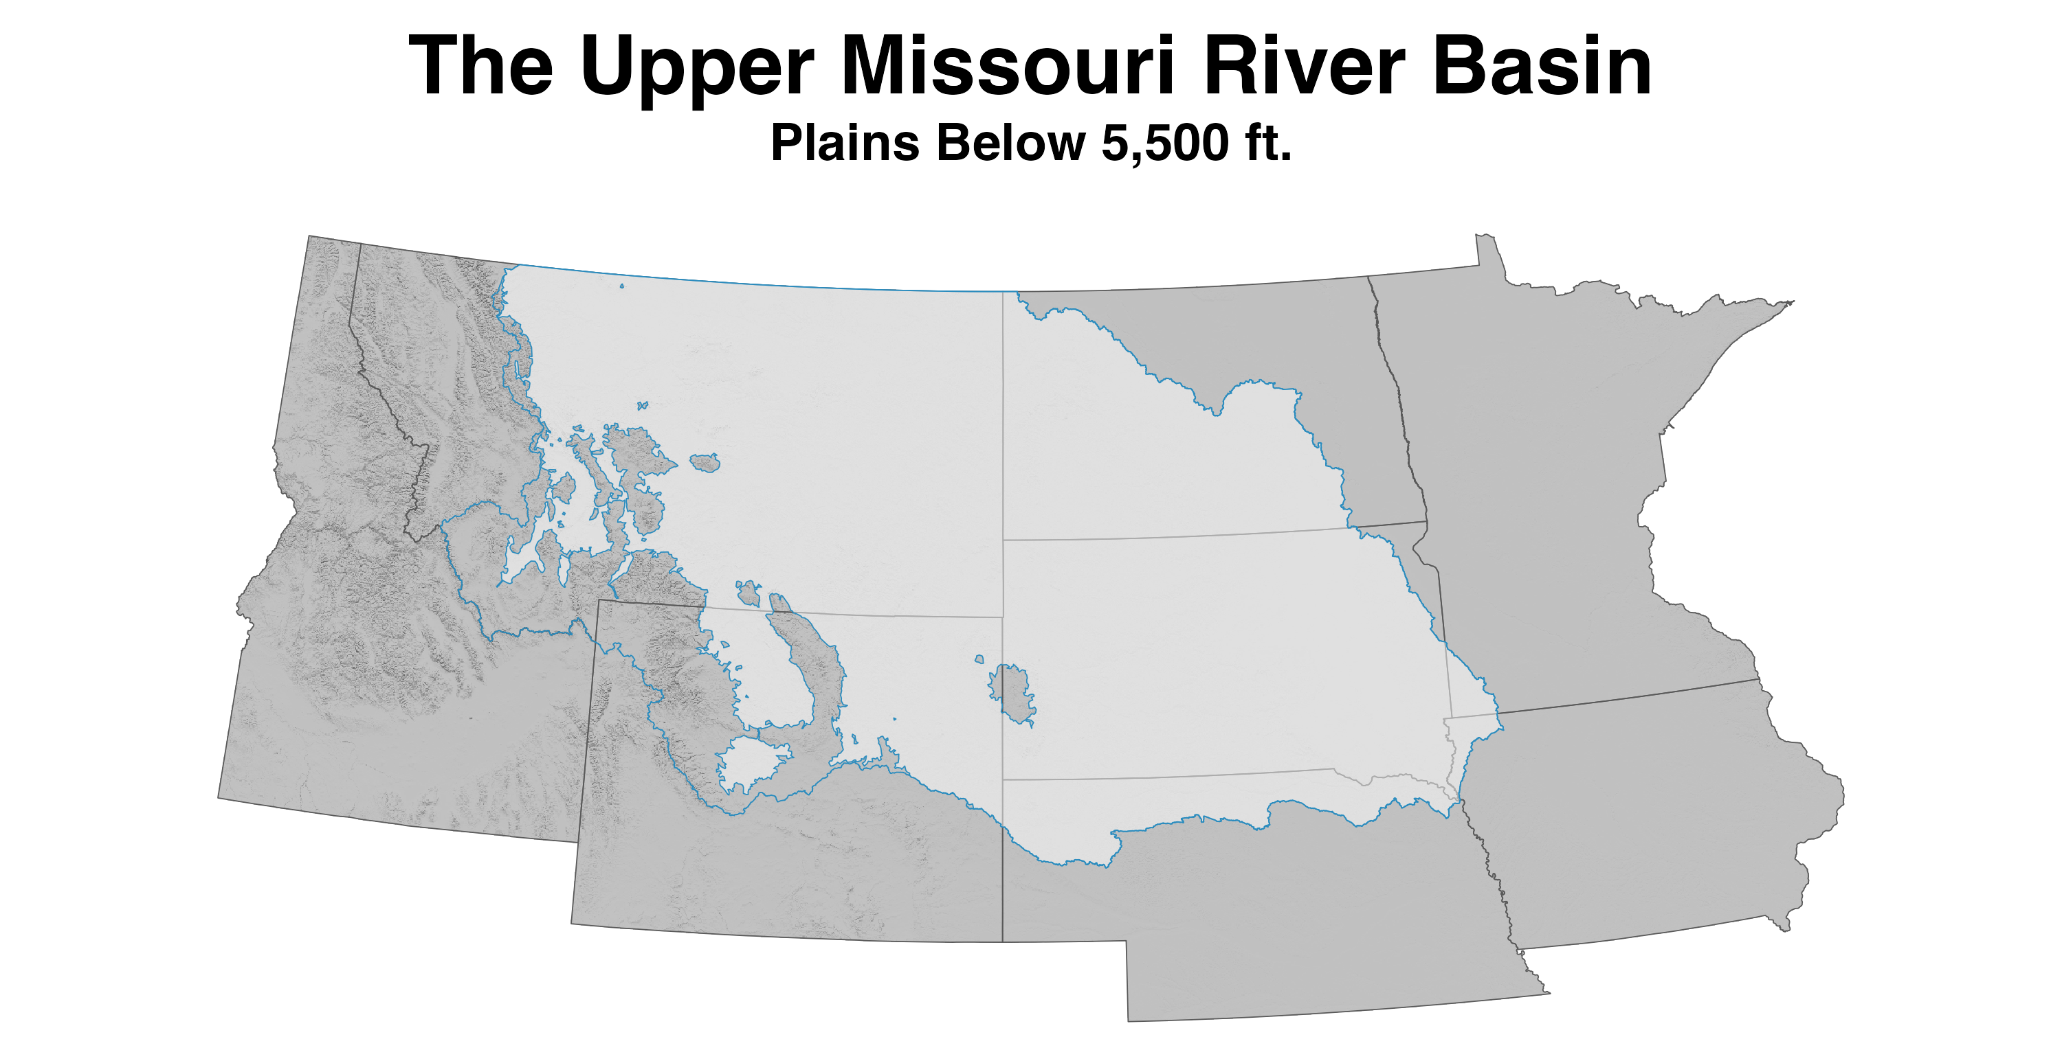

Slide 11
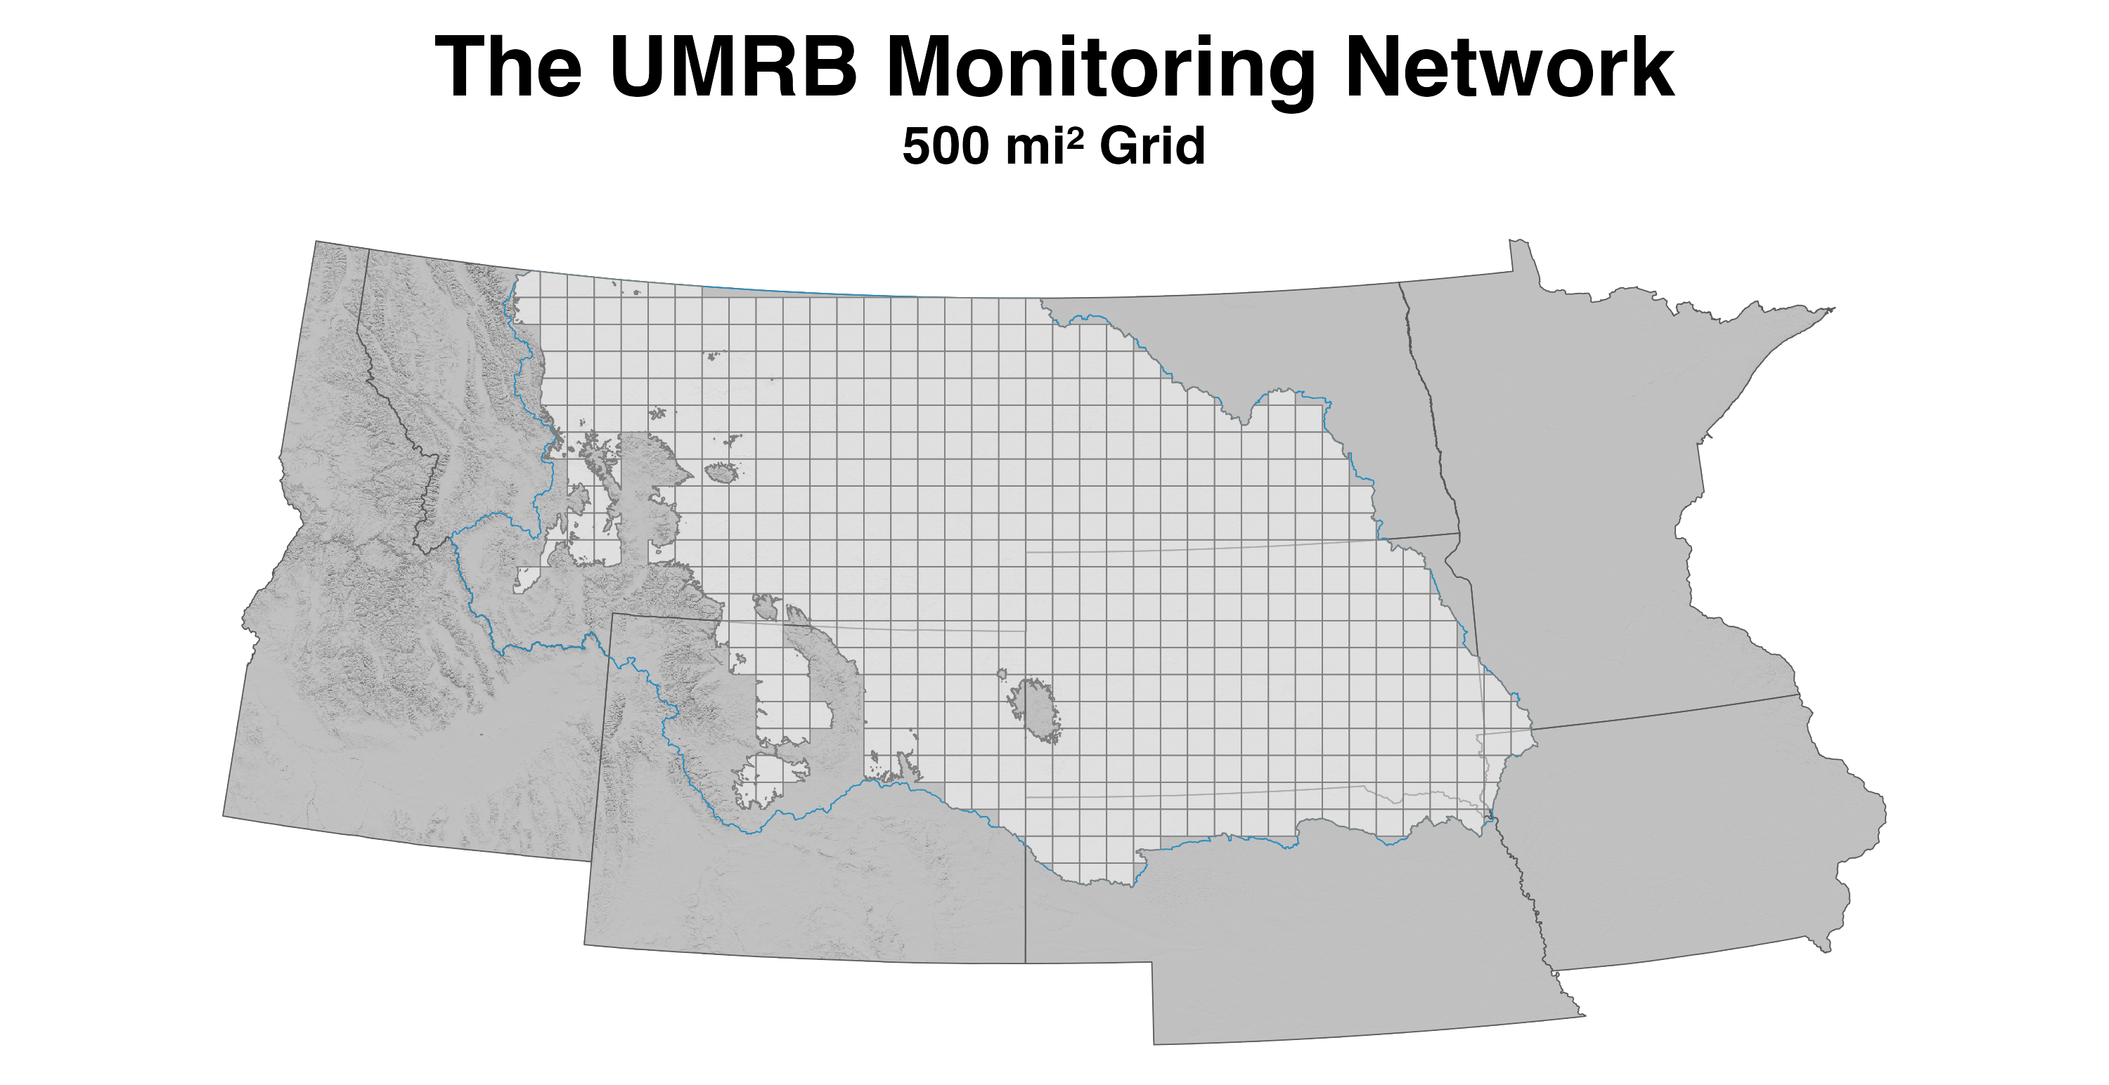

Slide 12
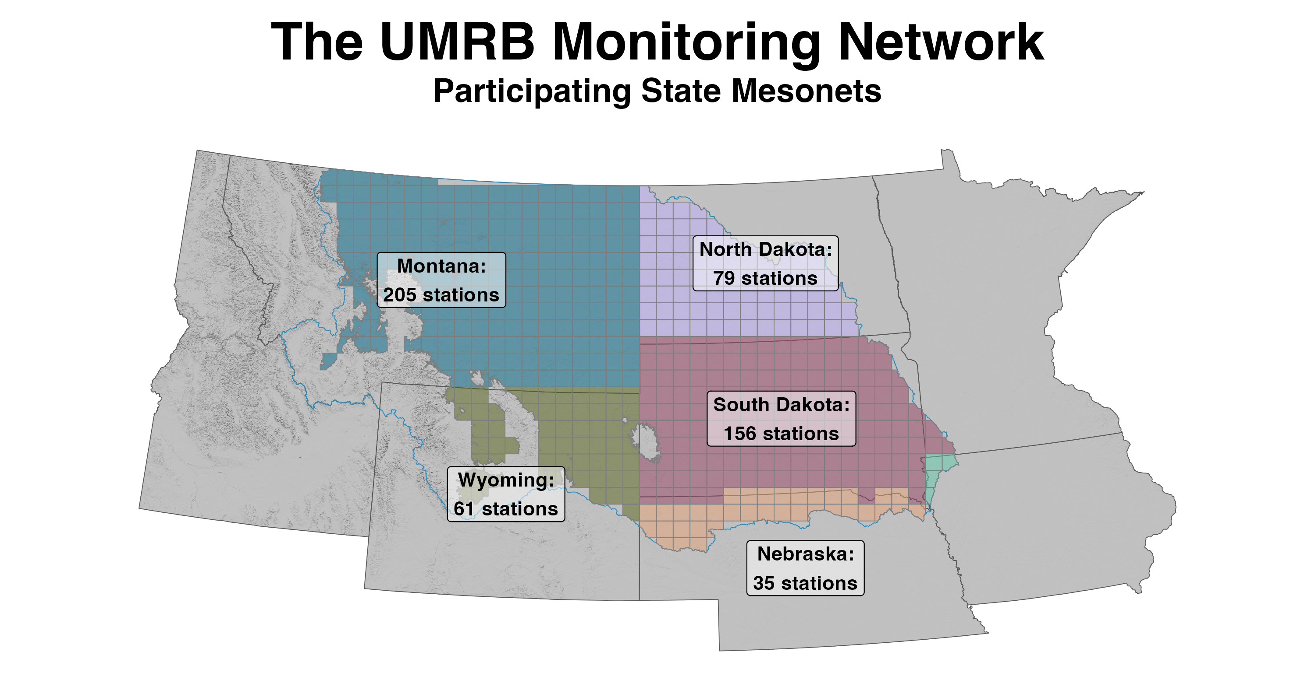

Slide 13
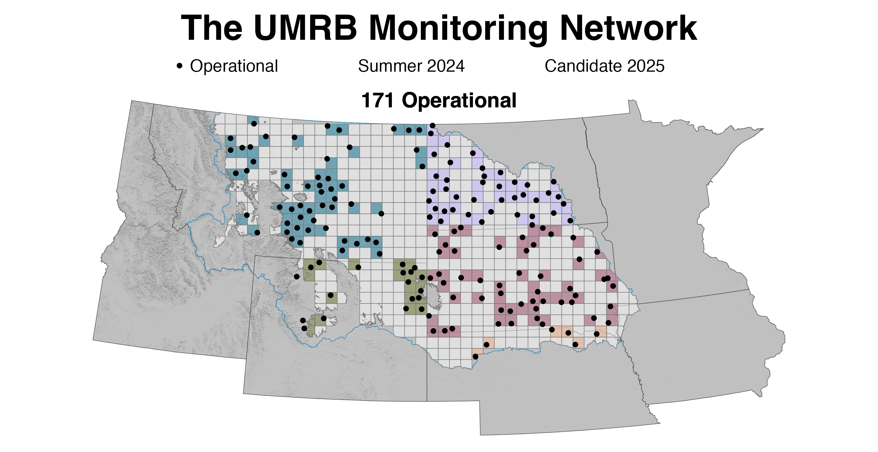

Slide 14
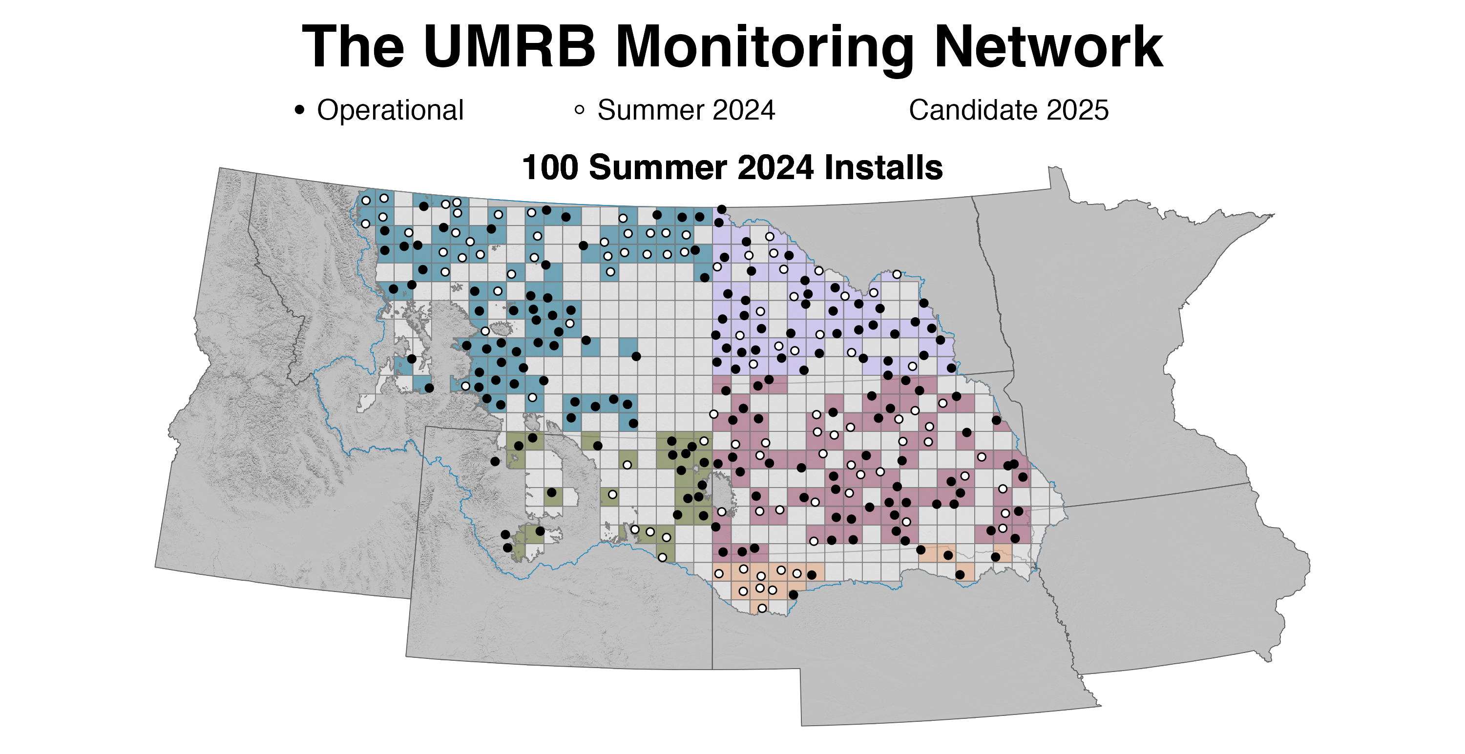

Slide 15
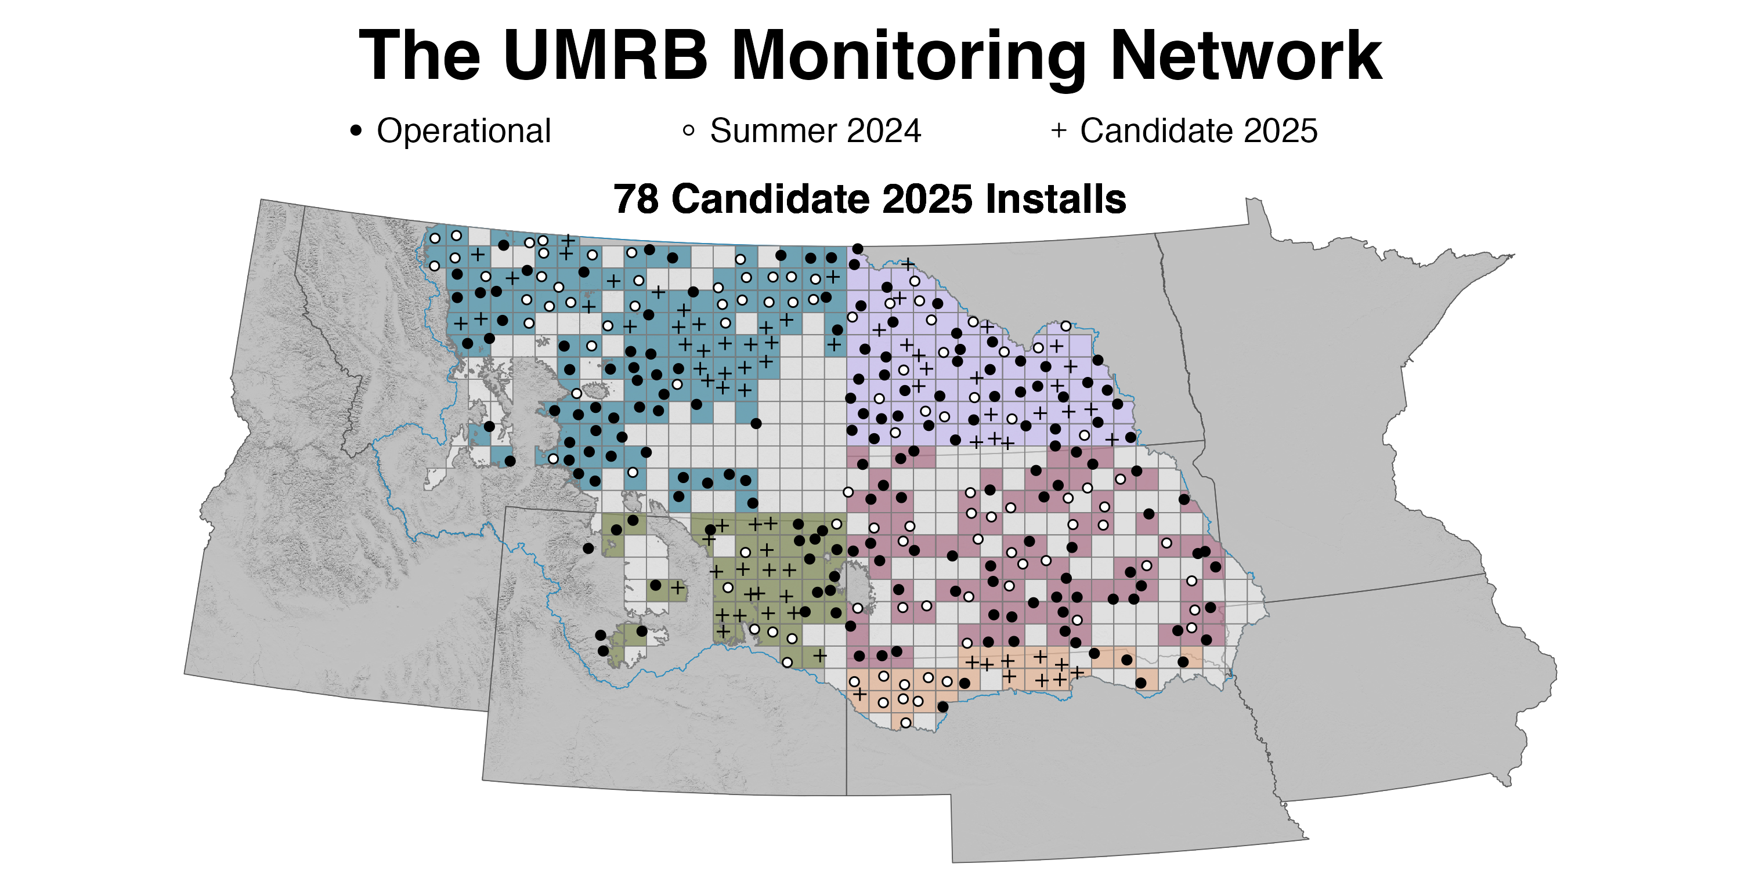

Slide 16
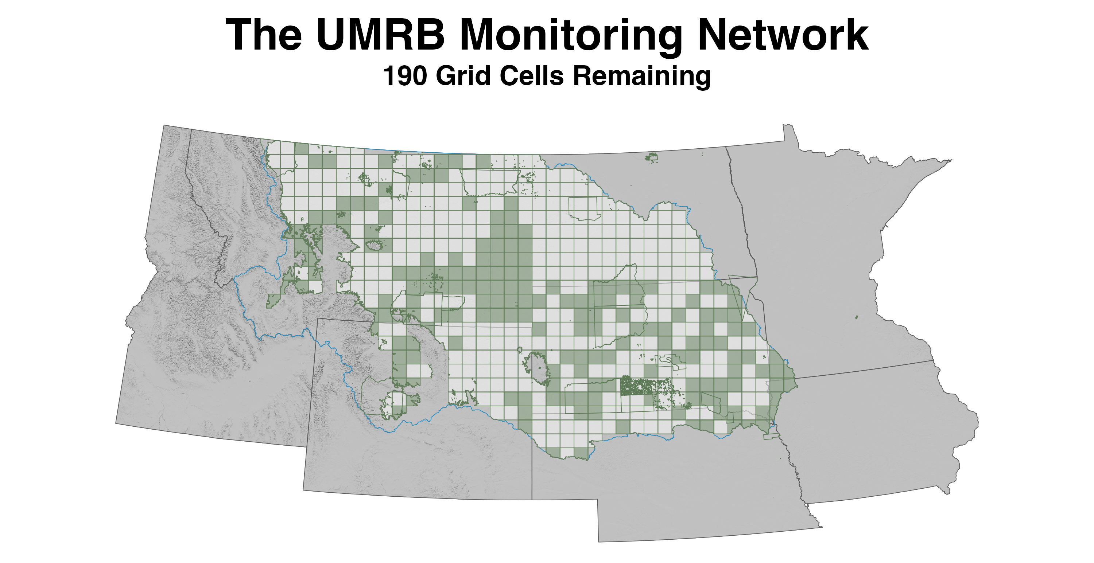

Slide 18
Partners Needed!
Email interest to Kevin Hyde
MT Mesonet Development Manager
kevin.hyde@umontana.edu

Slide 19
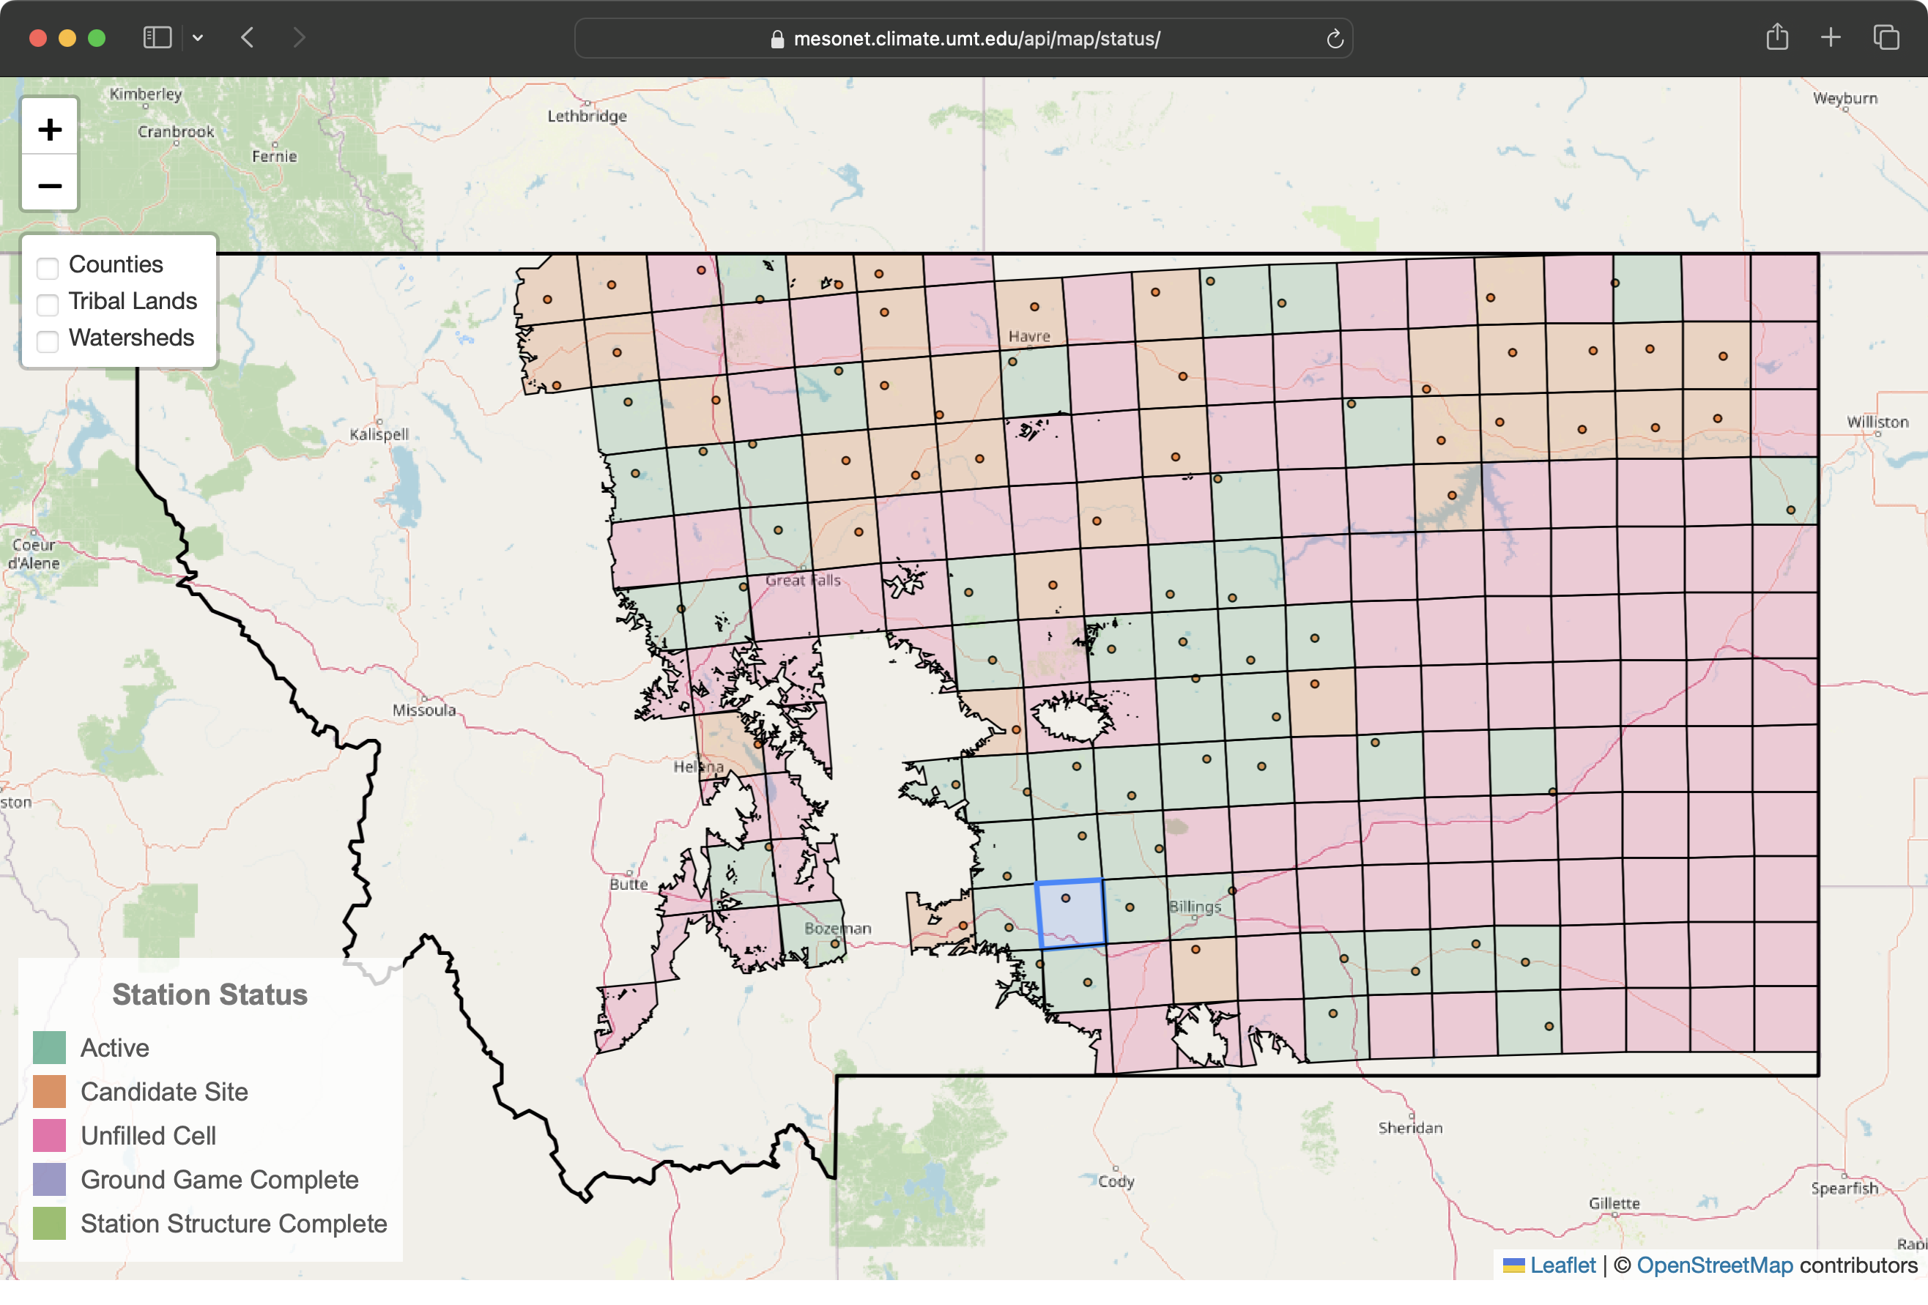

Slide 20
https://mesonet.climate.umt.edu/api/map/status/

Slide 21
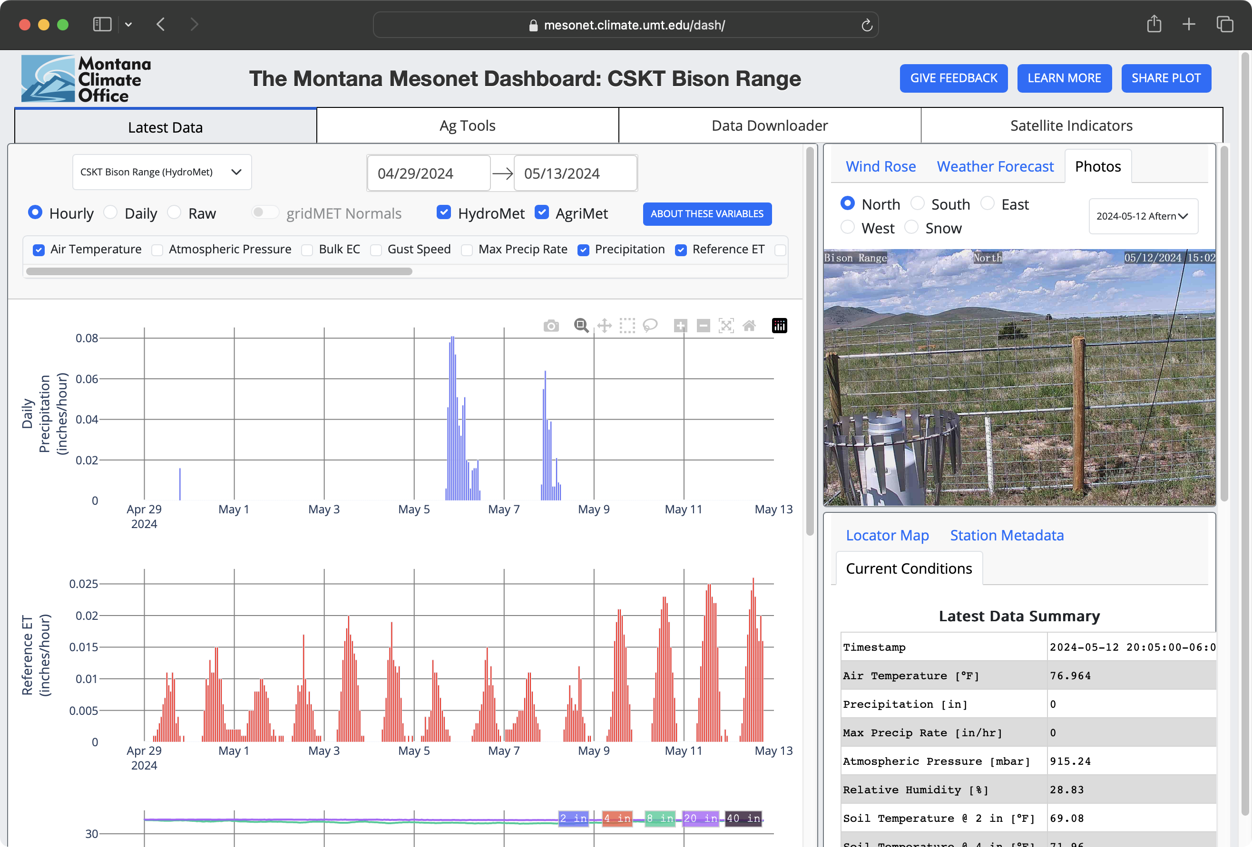

Slide 22
Publicly available API and dashboard
Map based and graphical summaries
Updated every 5 minutes (HydroMet) and 15 minutes (AgriMet)
Data used by NWS and USACE for flood/drought prediction, reservoir management, and more

Slide 23
https://mesonet.climate.umt.edu/dash/

Slide 24
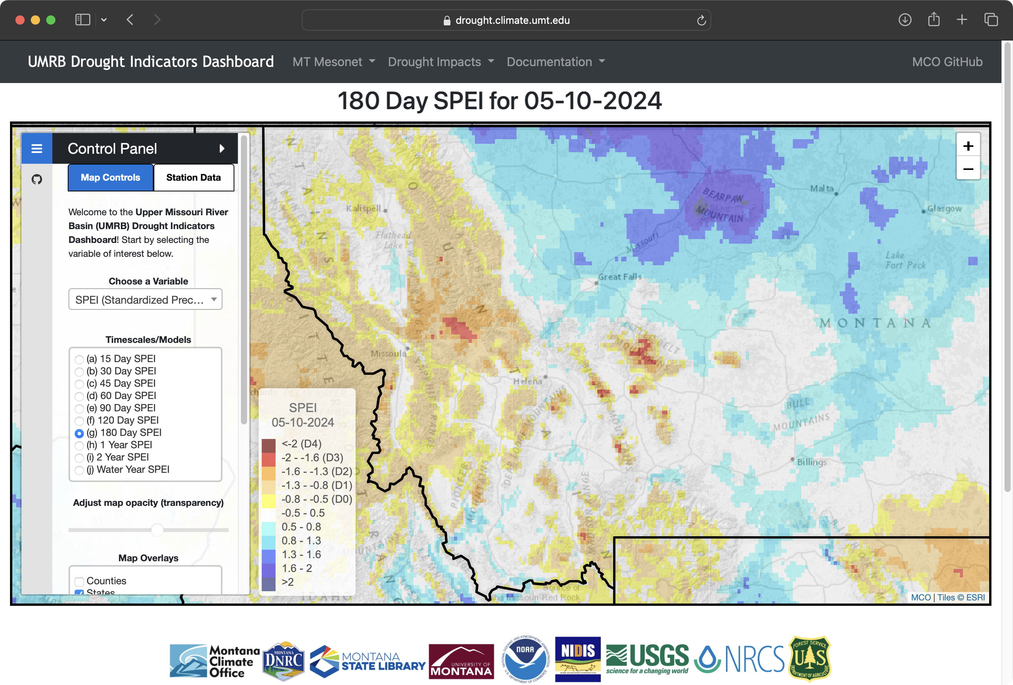

Slide 25


Operational drought models
Interactive
Daily to weekly
30m – 1km resolution
Local validation via MT Mesonet
These data form the basis for objective assessment by the monitoring committee and making our case to the USDM

Slide 26
https://drought.climate.umt.edu

Slide 27
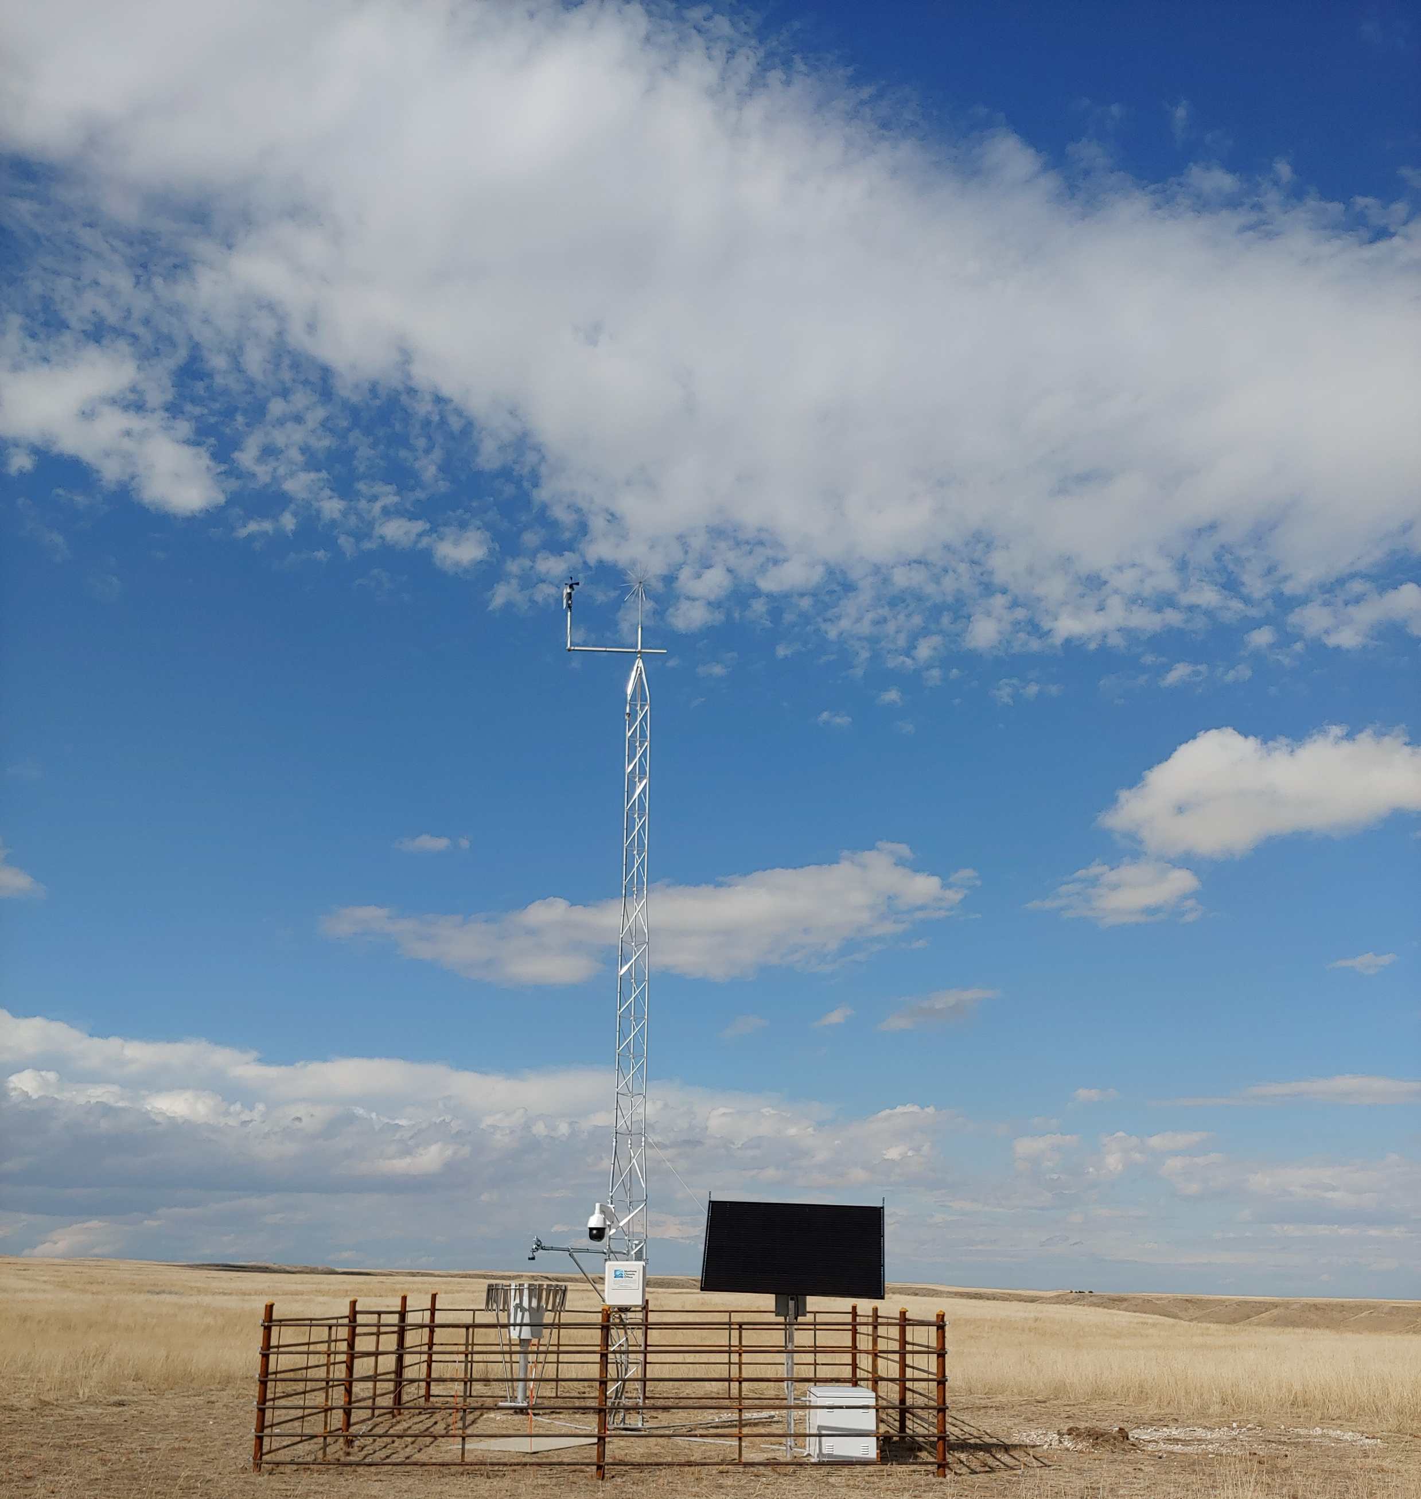
Thank You!
Questions?
kyle.bocinsky@umontana.edu
Montana Mesonet Station, Matador Ranch, Phillips County

